Slide 1
Arduino Lecture
Week 1

Slide 2
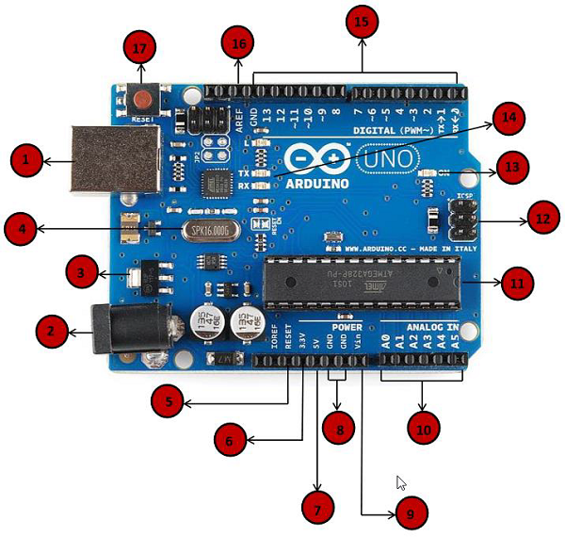
Arduino Hardware
This is an Arduino, and it’s made up of many different electrical components.
The next few slides will explain each component. In simple terms
If you wish, you may also refer to the link to gather a more in-depth understanding of each component.
https://www.tutorialspoint.com/arduino/arduino_board_description.htm

Slide 3
USB port that allows you to upload your program to
the arduino, also acts like a power supply
2) A power jack to provide power to the arduino
(9v external dc power source)
3) Power volt regulator that essential just regulates
the power in the arduino
4) Crystal oscillator that calculates time for the arduino

Slide 4
5) A reset pin to reset the arduino board
6-7) Supply power to the external parts on the arduino like an LED or LCD screen
3.3v and 5v
8) Ground pins that ground external parts on the arduino
9) VIN pin that allows the arduino to be powered from external power sources like AC batteries
10) Analog pins read input from analog sensors like humidity sensors or temperature sensors, Joystick movement

Slide 5
11) Microcontroller, basically the brains of the arduino
12) ICSP pins that allow you to program the arduino’s firmware
I would describe this as a more advanced topic. If you would like to learn more refer here (https://learn.sparkfun.com/tutorials/installing-an-arduino-bootloader)
13) The power LED indicator which displays whether the arduino powered on or not
14) TX and RX LEDS basically display the sending of serial data being transferred between the computer and the arduino, flashes at different speed depending on the baud rate used by the board
In depth guide on Serial Terminal Basics (https://learn.sparkfun.com/tutorials/terminal-basics/basic-terminology-)

Slide 6
15) Digital output and Input pins: these pins are used to configure external parts of the arduino like turning and LED off or on(pins which have PWM(Pulse width modulation) these pins are denote by “~”)
PWM will be covered later in the workshop
16) Stands for Analog Reference can be used to external set a reference voltage (between 0 and 5 volts) for analog input pins
17) Reset button to reset the arduino

Slide 7
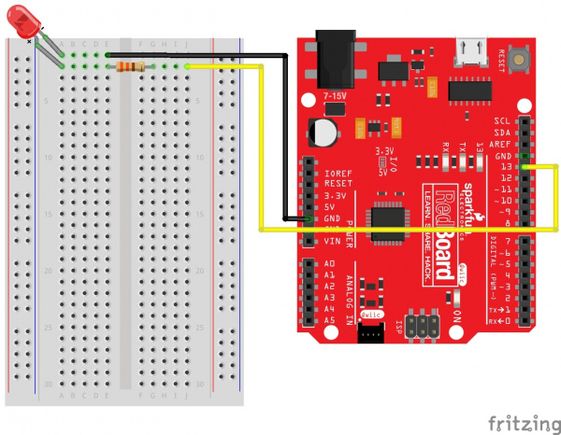
EXAMPLE 1: Turning an led off and on

Slide 8
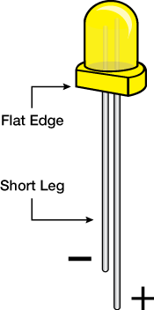
LEDS
Short leg is ground and longer leg is positive
LEDS can burn out if to much power is provided to them that’s why it’s important to have a resistor to limit the power being receive by the LED

Slide 9
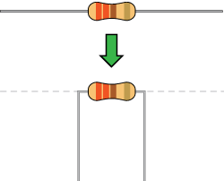
Resistors
What they basically do is resist the flow of electricity, the strength of which can be determined by the color of bands
More can be read here
https://learn.sparkfun.com/tutorials/resistors/decoding-resistor-markis
This resistor is going to be placed in front of the led in order to limit the flow of electricity the led is going to receive

Slide 10
Circuit: https://www.tinkercad.com/things/gfVuZhWRshg

Slide 11
Code
void setup() {
pinMode(9, OUTPUT); // Set pin 13 to output
}
void loop() {
digitalWrite(9, HIGH); // Turn on the LED
delay(2000); // Wait for two seconds
digitalWrite(9, LOW); // Turn off the LED
delay(2000); // Wait for two seconds
}

Slide 12
What each function does
Void setup(): This is the function used to initialize variables, pin modes, or use libraries. This function runs once
Void loop(): The loop functions repeats whatever is inside of it’s brackets until the arduino is turned off or the program is terminated
pinMode(): Before you can use one of the pins you need to tell the Arduino which pin it is using and whether this pin is going to act as an INPUT or OUTPUT
digitalWrite(): When using a pin as an oupt you can tell the pin to be either HIGH which turns it on or LOW which turns it off.
delay(): Causes the program to wait a certain amount of time in milliseconds before continuing

Slide 13
Sources
Arduino board
https://www.tutorialspoint.com/arduino/arduino_board_description.htm
https://www.circuito.io/blog/arduino-uno-pinout/
Circuit 1
https://learn.sparkfun.com/tutorials/sparkfun-inventors-kit-experiment-guide---v41/project-1-light
https://learn.sparkfun.com/tutorials/terminal-basics/basic-terminology-

